Slide 1

Classifyig Tweets for Disaster Detection
Davood Aein
Taraneh Javherpour

Slide 2
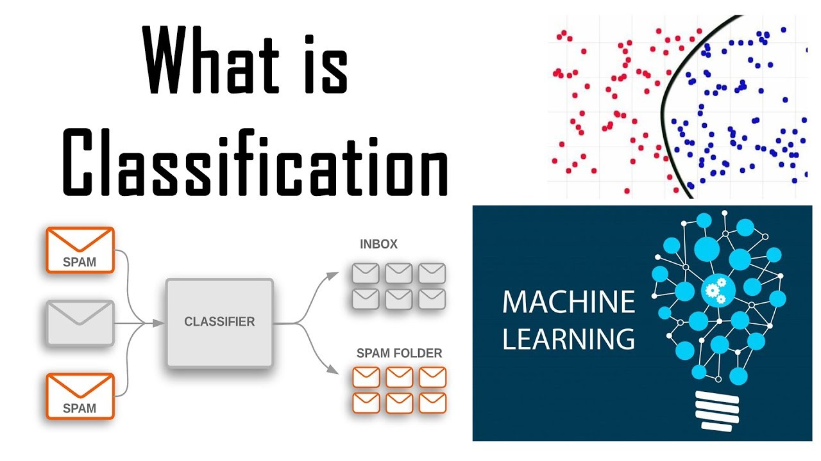
Classification Model (How It Works)

Slide 3
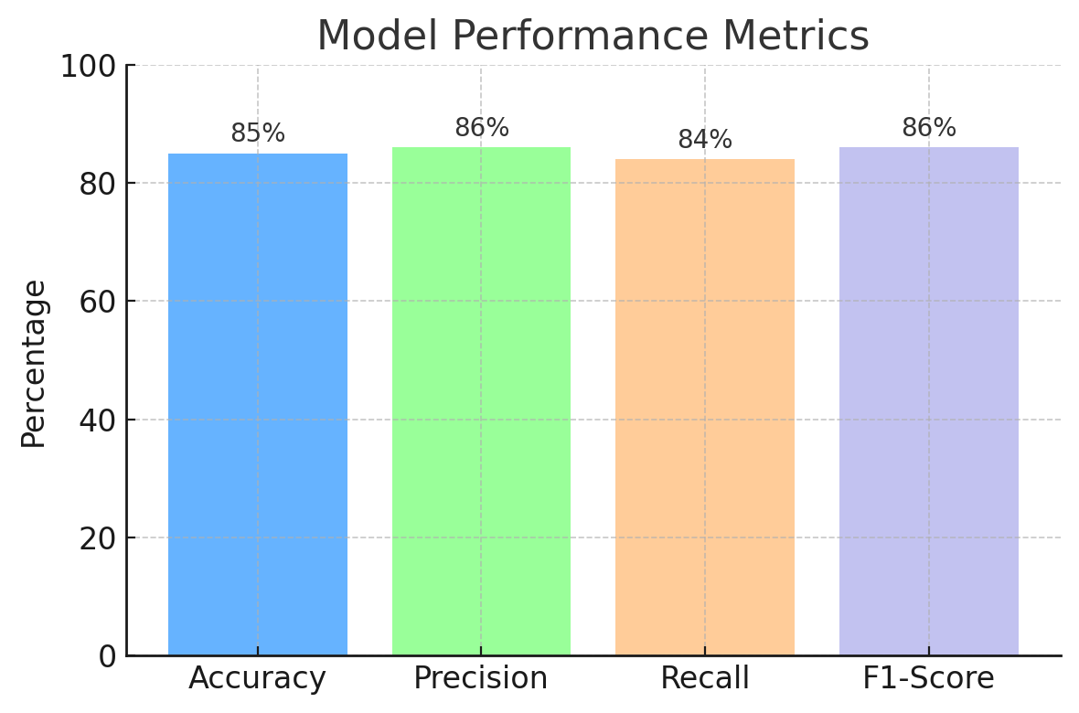
Model Performance Results

Slide 4
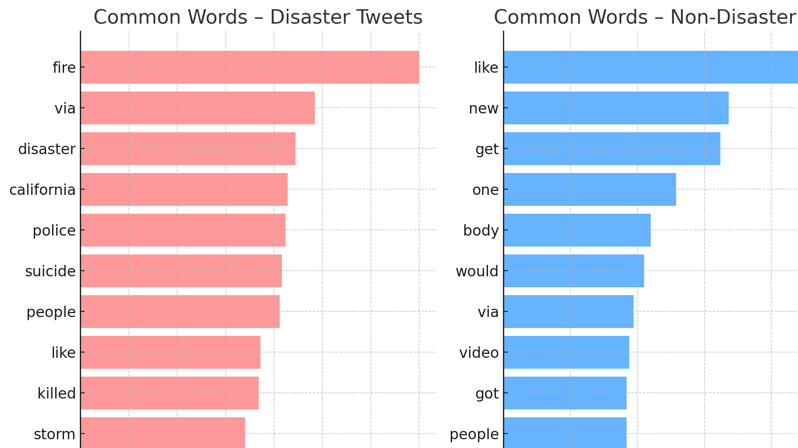
Topic Modeling (Unsupervisd Theme Discovery)

Slide 5

Real-World Applications

Slide 6

Next Steps & Future Improvements

